Slide 1



What is testing? inception and strategy fundamentals
Elias Liarakos, Test Manager
Elias Liarakos
liarakos@netcompany.com

Slide 2
What is testing?
Software testing can be stated as the process of:
Verifying and validating whether a software or application is bug-free (almost)
Meets the technical requirements as guided by its design and development
Meets the user requirements effectively and efficiently by handling all the exceptional and boundary cases.
The process of software testing aims not only at finding faults in the existing software but also at finding measures to improve the software in terms of efficiency, accuracy, and usability.

Slide 3
What is testing?
Testing Mindset
Testing Importance
Testing Strategy

Slide 4
Testing Mindset
A tester mindset is a way of thinking that involves looking at testing as an opportunity to uncover potential issues and improve the overall quality of an application. It consists of a willingness to think critically, question assumptions, and approach testing with a problem-solving mindset
A tester mindset is a way of thinking that involves looking at testing as an opportunity to uncover potential issues and improve the overall quality of an application. It consists of a willingness to think critically, question assumptions, and approach testing with a problem-solving mindset
A mothers’ mindset is a way of thinking that involves looking at her children as an opportunity to uncover potential issues and improve the overall quality of their life. It consists of a willingness to think critically, question assumptions, and approach children with a problem-solving mindset
So, do we all have testing mindset?

Slide 5


Testing Mindset

Slide 6


Testing Mindset
EXPLORATORY TESTING

Slide 7
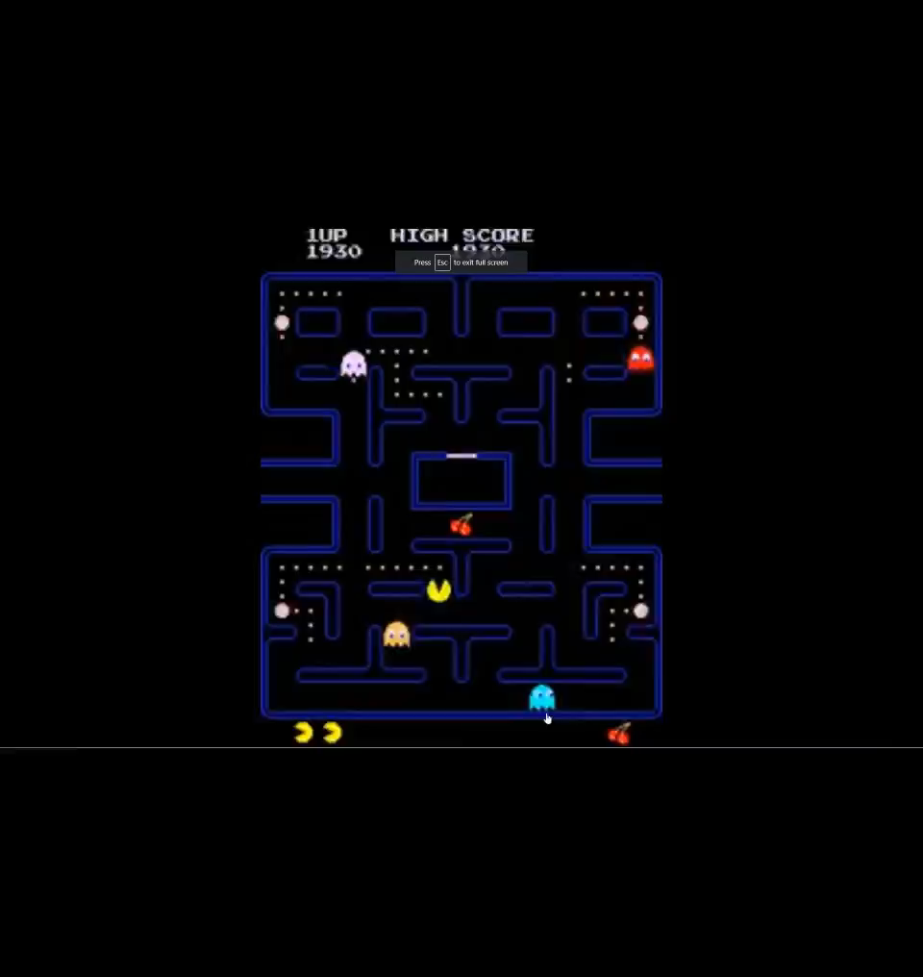
Testing Mindset
BUG REPRODUCTION

Slide 8
Testing Importance
IEEE – The Importance of Software Testing
Software testing reduces project risks related to software quality, security and performance. For example, software defects can lead to system failures, data breaches, slow performance and other significant impacts.

Slide 9
Testing Importance
1985: Canada’s Therac-25 radiation therapy malfunctioned due to a software bug and resulted in lethal radiation doses to patients leaving 3 injured and 3 people dead.
1994: China Airlines Airbus A300 crashed due to a software bug killing 264 people.
1996: A software bug caused U.S. bank accounts of 823 customers to be credited with 920 million US dollars.
1999: A software bug caused the failure of a $1.2 billion military satellite launch.
2015: A software bug in fighter plan F-35 resulted in making it unable to detect targets correctly.
2015: Bloomberg terminal in London crashed due to a software bug affecting 300,000 traders on the financial market and forcing the government to postpone the 3bn pound debt sale.
Starbucks was forced to close more than 60% of its outlet in the U.S. and Canada due to a software failure in its POS system.
Nissan cars were forced to recall 1 million cars from the market due to a software failure in the car’s airbag sensory detectors.

Slide 10
Testing Strategy
What is test strategy?
Test strategy in software engineering is an undeniable level arrangement or guide that frames the methodology, degree, assets, and timetable for executing the testing lifecycle in an application.
It characterizes the testing destinations, rules for progress, testing degree, and systems to be utilized. The essential point of implementing Software Testing Strategies in software engineering is to guarantee that the product meets its useful necessities, proceeds as expected, and is sufficiently strong to deal with true situations.
As such, a test procedure is a manual for ensuring the application is great and solid, helping analyzers know what to check, how to check, and when to check to ensure the product works impeccably.

Slide 11

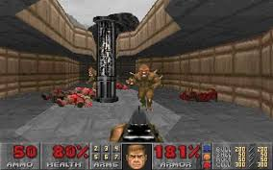

Testing Strategy
Understand the Product/Software: Get a comprehensive understanding of the application, including the technology, business logic, and user requirements. This will help you in identifying what kind of tests are needed.
Game = This is like learning and understanding the mechanics of a new game you just started playing.
Identify Objective: Determine the objective of your testing strategy. Are you validating specific features, or are you looking for bugs? The objective will help guide the rest of your strategy.
Game = Like how a gamer identifies their main objective in a game, whether it's to complete the main storyline, explore every corner of the game world, or achieve the highest score.
Stakeholder Identification: Identify the stakeholders in your project. These could be project managers, developers, customers, etc. Keep in mind their individual needs and expectations.
Game =It's like joining a gaming community where developers, experienced players, and newcomers come together to discuss and share experiences about the game.
Define Scope and Out of Scope: Clearly define what is in the scope of testing and what is not. This helps to avoid any confusion later on.
Game = Deciding which parts of the game you want to focus on. For example, you might decide to only complete the main quests and ignore the side quests.
Choose Testing Types: Decide on the types of testing needed (unit testing, integration testing, system testing, load testing, etc.) based on the software requirements and project scope.
Game = Trying different gameplay styles or strategies. Like choosing between stealth or direct combat in a game like Assassin's Creed.
Risk Analysis: Identify potential risks that could affect the testing process or the software's performance. Create contingency plans for these risks.
Game = This could be like considering the possible outcomes or consequences of an in-game decision. For instance, choosing one faction over another in a game could lead to different story outcomes.
Define Test Criteria: Set the pass and fail criteria for each test. This will make the testing process more objective and measurable.
Game = Setting personal goals or achievements in the game, like reaching a certain level or mastering a skill.

Slide 12

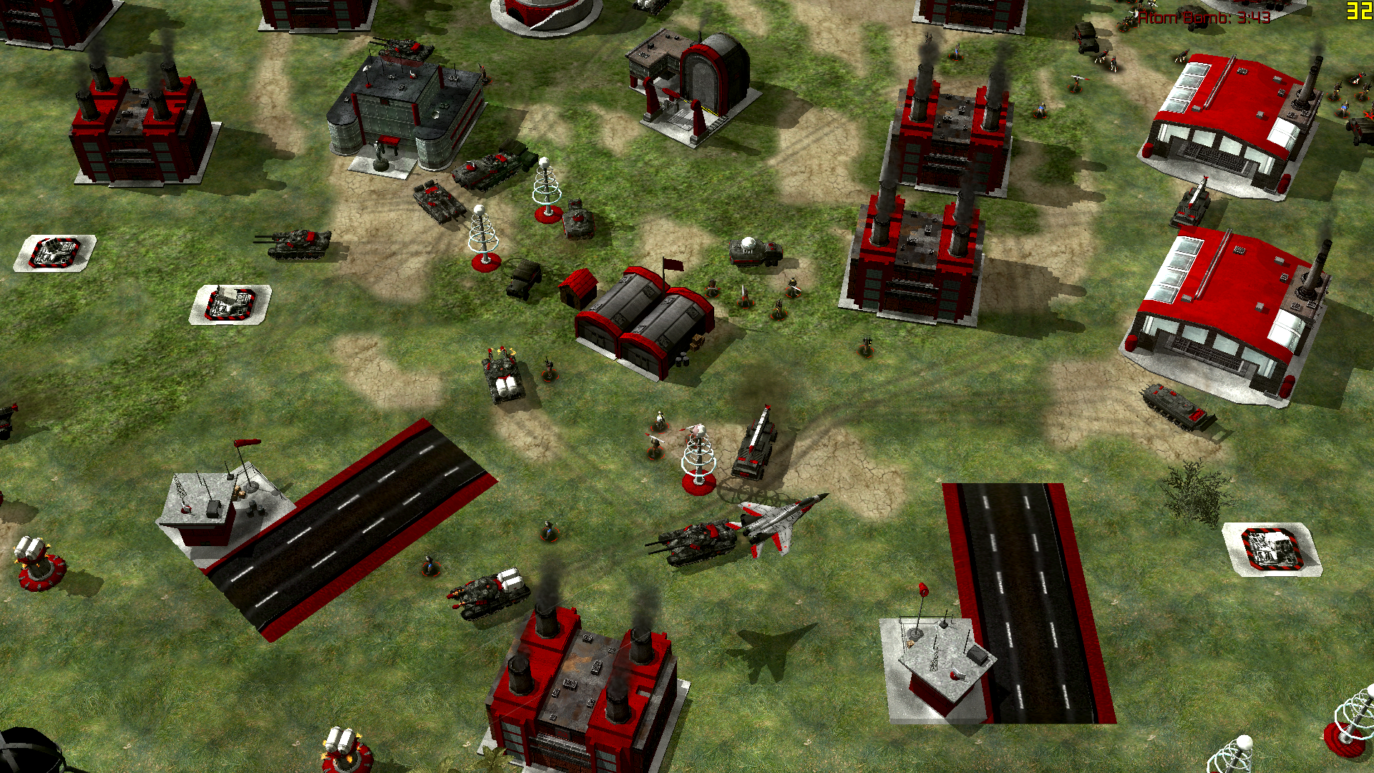
Testing Strategy
Schedule and Estimation: Create a timeline for your testing process. This should include the estimated time for each stage of testing.
Game =Scheduling gaming sessions and estimating how much time it might take to complete certain tasks or missions in the game.
Test Tools: Identify and prepare the tools you will use for testing. These could include automated testing tools, bug tracking tools, etc.
Game = Using aids to improve gameplay, like strategy guides, walkthroughs, or even in-game tools like maps or inventory management systems.
Review and Approval: Once the test strategy has been created, it should be reviewed and approved by the stakeholders. This ensures that everyone is on the same page and agrees with the approach.
Game = : Sharing your gaming experiences with others for feedback, like posting game reviews or discussing strategies on gaming forums.
Documentation: Document the strategy in a Software Test Strategy document. This document should be kept up-to-date as changes occur.
Game = This could be like keeping a gaming journal where you document your progress, strategies, and experiences in the game.
Resource Planning: Determine what resources (people, software, hardware, etc.) you will need for testing. Plan for their availability and training if necessary.
Game = This is like managing in-game resources such as health packs, equipment, or character abilities for achieving objectives.
Test Environment: Define the environment in which testing will take place, including the necessary hardware and software configurations.
Game = Setting up the right environment for gaming, such as choosing a quiet room, getting a comfortable chair, or using a high-performance gaming PC.
Test Data Management: Plan for the management of test data. You will need to decide on how to create, manipulate, and store data used in testing.
Game = Recording game progress, like taking note of character stats or saving game progress at crucial points.

Slide 13
STSC
1 Independent Test Team
1 Mission → Improve SW Quality
162 Test Analysts & Test Engineers
45% ISTQB Certified Members
87 Different Applications / Systems under Test
34 Different Projects / Products
24 Years Old Test Team
5 Internal Testing Training Programs / Paths
3100 Wiki Pages Created by our Members for Testing Topics/Tips
Let’s talk with numbers…
About our Team

Slide 14
Thank you!

